Slide 1
OECS JUVENILE JUSTICE REFORM PROJECT/ JUDICIAL EDUCATION INSTITUTE (JEI) OF THE EASTERN CARIBBEAN SUPREME COURT
MAGISTRATES CONFERENCE
TRAINING WORKSHOP FOR THE CARIBBEAN
LOOKING TOWARDS A NEW DAWN: DIVERSION IN JUVENILE JUSTICE
26-28 August, 2013
The Verandah Resort & Spa Antigua
Indian Town Road, Long Bay, Antigua and Barbuda
Facilitator: Hazel Thompson-Ahye LLM Merit Family Law

Slide 2
SESSION 1 : SETTING THE CONTEXT: AIMS AND OBJECTIVES
AIM:
To critically assess the nature, role and use of diversion in the juvenile justice reform process.
OBJECTIVES: At end of the training, participants should be able to:
Explain the guiding principles in juvenile justice;
Define diversion and its role in juvenile justice;
Explain conditions for diversion;
Describe various models of diversion;
Analyse suitability of various models of diversion
Design strategies for reform of juvenile justice system to include diversion.

Slide 3
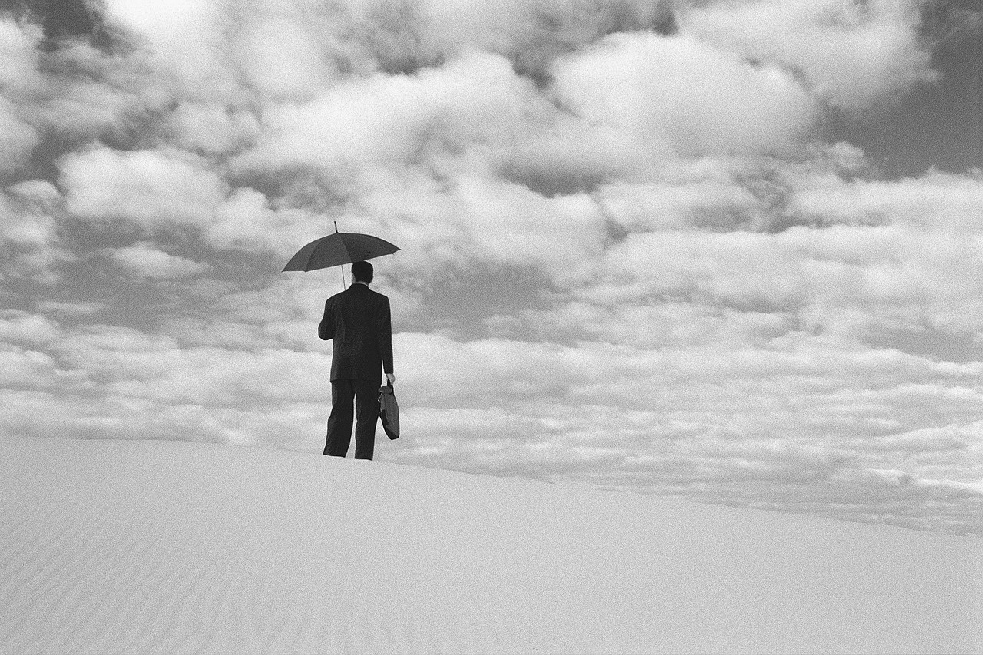
FUNDAMENTAL /UMBRELLA PRINCIPLES of the CONVENTION ON THE RIGHTS OF THE CHILD
Article 2: non-discrimination
Article 3: best interests of the child
Article 6: child’s right to life, survival and development
Article 12: right to be heard

Slide 4
Umbrella Principles of the CRC
Non-discrimination (article 2)
Ensure equal treatment of children;
Avoid de facto discrimination;
Train all juvenile justice personnel;
Establish rules, regulations, protocols;
Give support, assistance for reintegration;
Abolish status offences- both sexes;
Implement child protective measures.
4
Notes:
10/16/2013

Slide 5
Umbrella Principles of the CRC
Best interests of the child (article 3)
Primary consideration in all decisions affecting children;
Children different from adults-basis for their lesser culpability;
Require separate juvenile justice system;
Discard retributive principle, embrace restorative justice;
Maintain concern for public safety.

Slide 6
Umbrella Principles of the CRC
Right to life, survival and development (art 6)
- an inherent right;
Delinquency - very negative impact on a child’s development;
Policies must support child development;
No death penalty;
No life sentence without parole;
Detention- as measure of last resort and for shortest possible time.
6
Notes:
10/16/2013

Slide 7
Umbrella Principles of the CRC
RIGHT TO BE HEARD (article 12)
Fundamental to a fair trial.
Respect child’s right to express views freely.
Right to be heard in all matters affecting him/her.
Implement at every stage of juvenile justice process.

Slide 8
CRC articles on juvenile justice:
Treatment in detention (article37)
No torture, cruel, inhuman, or degrading treatment or punishment;
No capital punishment, life imprisonment;
Arrest, detention, imprisonment-lawful;
Treat with humanity, respect, regard age;
Separate from adults, unless not in best interests;
Allow family communication;
Provide legal/other assistance;
Give right to challenge detention, prompt decision.

Slide 9
CRC articles on juvenile justice
Child in conflict with law (article 40.1)
Treatment must be consistent with child’s sense of dignity and worth;
Reinforce child’s respect for human rights and freedoms of others;
Take account of child’s age;
Promote reintegration, child’s assuming a constructive role in society.

Slide 10
CRC articles on juvenile justice
Guarantees of a fair trial (article 40. 2)
No retroactive juvenile justice;
Presumption of innocence;
Inform promptly and directly of charge;
Legal/other appropriate assistance;
Decision: prompt, by competent, impartial body;
Right: silence, examine/call witnesses,
to appeal, to have interpreter;
Right: privacy at every stage of process.

Slide 11
CRC articles on juvenile justice
Juvenile justice system (Article 40.3)
Establish a comprehensive juvenile justice system with–
-laws, procedures, authorities and institutions specifically applicable to children in conflict with the law;
- a minimum age of criminal responsibility;
- alternative pretrial measures.

Slide 12
CRC articles on juvenile justice
Dispositions by juvenile court (art.40.4)
Variety of dispositions: for proportionality
Care;
Guidance;
Supervision orders;
Counselling;
Probation;
Foster care;
Education and vocational training;
Other alternatives to institutional care.

Slide 13
Other relevant CRC articles
Promote physical/ psychological recovery social reintegration of child victim of abuse, torture, cruel, inhuman, degrading treatment or punishment. (article 39)
States must undertake appropriate legislative, administrative, other measures to implement child rights.
Implement economic, social and cultural rights- within maximum resources of State. (article 4)

Slide 14
INTERNATIONAL STANDARDS AND NORMS IN JUVENILE JUSTICE
UN Guidelines for the Prevention of Juvenile Delinquency (Riyadh Guidelines)
UN Standard Minimum Rules for the Administration of Juvenile Justice(Beijing Rules)
UN Rules for the Protection of Juveniles Deprived of their Liberty (Havana Rules)
N.B. (1) Child Rights Committee's General Comment
No.10: Children’s rights in juvenile justice.
(2) Vienna Guidelines for Action on Children in the Criminal Justice system.

Slide 15
RIYADH GUIDELINES
General Principles:
Proactive approach needed;
Delinquency prevention= crime prevention;
Recognize, promote, respect human rights;
Fair and just society= reduce motivation and conditions of crime;
Focus on child’s well-being from early childhood;
Develop community services, programmes;
Last resort: formal agencies of control.

Slide 16
RIYADH GUIDELINES
Socialization processes: Emphasis –preventive.
FAMILY: central unit of society –high priority- needs, well-being of all family members.
EDUCATION: available to all children- highest standard- academic, vocational
Develop personality, talents, mental, physical;
Teach basic values, rights, responsibilities;
Identify those at risk, provide services;
Sensitize teachers, others, to youth problems;
Avoid harsh discipline, corporal punishment;
Promote fair, just policies –involve students.

Slide 17
RIYADH GUIDELINES
Socialization processes
Community: Provide services, programmes to fulfil needs, interests, concerns of youth;
Counselling, guidance, recreation centres, shelter, therapy other assistance.
Mass media: Provide access to information-national, international services, facilities, opportunities;
Portray positive contribution of youth;
Seek minimize pornography, drugs, violence;
Avoid demeaning, degrading women and youth;
Be aware of social role and responsibility.

Slide 18
RIYADH GUIDELINES
Social policy: high priority: plans, programmes;
Institutionalization: last resort, minimum period;
Best interests: paramount;
Prevention programmes: Monitor, evaluate, adjust;
Educate: recognize abuse; policies for prevention.
Legislation and juvenile administration
Enact, enforce special laws promote protect youth;
Abolish status offences
Establish independent organ: protect rights, interests
Train personnel to maximize diversion measures.
Research, policy development, coordination
Multidisciplinary, intradisciplinary, national, regional, international;
Share information, experience and expertise.

Slide 19
BEIJING RULES
Fundamental Principles
Promotion of well-being of juvenile and family using positive measures;
Ensure a meaningful life in community;
Mobilize all resources to reduce intervention;
View juvenile justice as integral to national development and within framework of social justice and implement within economic, social, cultural conditions;
Systematically develop and co-ordinate services to improve and sustain competence of juvenile justice personnel.

Slide 20
BEIJING RULES
Rules: Scope of rules, Definitions
Juvenile: child or young person under a legal system who is dealt with differently from adults.
Offence: any behaviour (act or omission) punishable by law under the State’s legal system.
Juvenile offender: child/young person alleged to have committed/found to have committed crime.
Rules must be applied impartially to all juveniles;
States: Establish juvenile justice system with laws, rules to meet varying needs of juveniles/ society;
Rules must be implemented thoroughly and fairly.

Slide 21
BEIJING RULES-
Application, age of criminal responsibility, aims
Apply to juveniles-offences, any specific behaviour not punishable if adult- status offences;
Should extend to juveniles in welfare and care proceedings, young adult offenders.
Age of criminal responsibility should not be fixed at too low an age level, bearing in mind emotional, mental and intellectual maturity.
Aims: well-being of juveniles,
Reaction: proportionate-offender and offence,
Discretion: exercisable at all stages;
Qualified, trained personnel: exercise functions judicially.

Slide 22
BEIJING RULES
Basic rights/investigation/prosecution
Presumption of innocence; right to silence, privacy
To be notified of charges,
To counsel, to have parent/guardian present;
To confront and cross-examine witnesses; appeal;
Parents to be notified upon arrest of juvenile;
Release to be considered without delay;
Legal status of juvenile to be respected;
Promote well-being, avoid harm;
Police, prosecution-discretion-avoid formal trial;
Diversion with consent and subject to review;
Specialized training for police officers;
Specialized units to be developed, if feasible.

Slide 23
BEIJING RULES
Detention/adjudication/ disposition
Detention-last resort, shortest possible time.
Consider alternatives.
Separate juveniles from adults.
Entitled to rights, receive, care, protection, all necessary assistance -age, sex, personality.
Fair trial by competent authority;
Proceedings in best interest, conducted with understanding for full participation of juvenile;
Right to counsel, for parents to participate;
Use pre-sentence/social enquiry report.
No corporal punishment, capital punishment.

Slide 24
HAVANA RULES
Fundamental perspectives
Juvenile justice system-uphold rights, safety, promote physical, mental well-being of juveniles;
Deprivation liberty: last resort, minimum period;
Minimum UN standards, consistent with human rights, fundamental freedoms;
Guide for professionals – monitor application;
Prevent detrimental aspects- aid reintegration;
Apply impartially, respect for juvenile’s religious, cultural beliefs, practices, moral concepts, culture;
Incorporated in legislation;
Open contact with community should be fostered.

Slide 25
HAVANA RULES
Scope /Application: Every person under age 18
Any form of detention
Must have meaningful programmes
Conditions must ensure human rights
All rights compatible with detention to be ensured
Inspection-by duly constituted independent body–ensure legality of detention, consistency with international standards
Rules: in accord-economic, social, cultural conditions
Awaiting trial-Entitlements: presumption of innocence, speedy trial - shortest detention, separate detainee from convicted juveniles, rights, counsel,
Voluntary remunerated work, continuing education and training, material for leisure and recreation.

Slide 26
HAVANA RULES
Management of juvenile facilities
Keep all records on juvenile in confidential file;
Prevent access to unauthorized 3rdparty;
Records must be sealed and later expunged;
Order for admission made by competent authority;
Enter details of admission order in register;
Notify parents of admission, transfer, release;
Provide juveniles with copy of regulations;
Transport juveniles free of charge and under proper conditions.

Slide 27
HAVANA RULES
Classification and placement
Shortly after admission, interview juvenile, prepare psychological and social report identifying nature of care and programme required;
Submit reports to director to determine care;
Prepare individualized treatment plan if special rehabilitation treatment required and feasible;
Detention must be under conditions -take account of special needs and ensure protection from harm;
Detention facility should be open, decentralized and small.

Slide 28
HAVANA RULES
Physical environment and accommodation
Facilities in keeping with health, human dignity, rehabilitation;
Provide privacy, opportunities to associate with peers, sports, physical exercise, leisure, free from health risks, other hazards
Small dormitories, regular, unobtrusive supervision during sleeping hours, separate, sufficient, clean bedding, personal storage, meals at normal times, clean drinking water.
Education, vocational training and work
Right to education ,including vocational education, suited to their needs and abilities, outside the facility, where possible. Certificates not to show juvenile in institution.
Facility must have adequate and suitable library.
Child labour laws also protect juveniles.
Moneys earned are for the juvenile's use and benefit.

Slide 29
HAVANA RULES
Recreation and religion
Daily exercise in open air, equipment for recreation and other leisure activities.
Entitled to practise religion, right not to participate in religious activities should be respected and facilitated.
Medical care
Adequate and holisitc medical care, preventive and remedial- in community, if possible.
Medical examinations upon admission.
Doctor -report if health injuriously affected by detention.
Treat mental illness in specialized institution.
Qualified personnel to conduct drug abuse and rehabilitation programmes.
Medication, only if prescribed for treatment.

Slide 30
HAVANA RULES
Notification of illness, injury and death
Family -immediately informed of any serious illness, death, transfer to external health facility of juvenile;
Nearest relative- right to inspect death certificate, see body, determine disposal of body.
Independent enquiry must be held when death occurs during detention or within six months after release, if believed detention-related .
Juvenile to be informed of death or serious illness of close family member, allowed attend funeral, visit.

Slide 31
HAVANA RULES
Contact with wider community
Right to fair and humane treatment, reintegration -adequate communication- community-family, friends.
Allow home visits, family and leave facility for educational, vocational, other important reasons.
Allow regular, frequent family visits in privacy.
Assist juvenile to exercise right to correspondence, telephone communication at least twice weekly.
Access to information- radio, newspapers, television.

Slide 32
HAVANA RULES
Limitations: physical restraint and use of force disciplinary procedures- safeguard human rights
Instruments-restraint/force- for short while, last resort To prevent juvenile's injury to self, others, property,
Discipline- for safety, order, uphold dignity, instil
justice, self- respect, respect -rights of others.
No cruel, inhuman, degrading treatment,
No corporal punishment, placement in dark cell, closed/ solitary confinement, diet restriction,
No denial of family contact, enforced labour,
No double or collective sanctions.

Slide 33
HAVANA RULES
Inspection and complaints
Qualified independent inspectors -undertake unscheduled, regular visits to facility, have access to all staff, all juveniles and records.
Doctors to participate in inspection, evaluate compliance with rules regarding physical plant, hygiene, food, other conditions affecting juvenile.
Report submitted should include findings, evaluation, compliance, recommendations.
Juveniles entitled to make complaints, requests to authorities should receive assistance to do so.

Slide 34
HAVANA RULES
Return to the community
All juveniles should get assistance from programmes designed to help with reintegration to society, family life, education or employment.
Consider early release, special courses.
Provide services to facilitate successful reintegration, lessen prejudices.
Services should include residence, employment, clothing and sufficient means to maintain self upon release.
Service providers to meet juveniles pre-release.

Slide 35
HAVANA RULES
Personnel - Careful selection and recruitment
Qualified, sufficient specialists: instructors, counsellors, social workers, psychiatrists, psychologists.
Adequate remuneration for suitable personnel-perform in humane, committed, professional ,fair, efficient manner to gain respect of juvenile.
Facility should facilitate communication among all staff to ensure efficient fulfilment of duties.
Training for effective performance, particularly in child psychology, welfare, international norms and rights of the child.
Director- well-qualified, administrative ability and suitable training and experience.

Slide 36
HAVANA RULES
Personnel
Staff must respect and protect juvenile's human dignity and fundamental rights- may not inflict, instigate,tolerate torture, harsh, cruel, inhuman, degrading treatment of juvenile;
Staff should oppose and report corruption promptly, respect rules and report serious violations, protect from physical, sexual, emotional abuse and exploitation and safeguard juvenile's right to privacy/ confidentiality of matters learnt in course of duties;
Minimize differences from life outside facility which tend to lessen respect for human dignity of juvenile.

Slide 37
U.N. COMMITTEE ON THE RIGHTS OF THE CHILD GENERAL COMMENT NO.10 ( 2007) Children’s rights in Juvenile Justice
Core elements of juvenile justice policy
Prevention of juvenile delinquency;
Intervention/Diversion-without judicial proceedings and in context of judicial process;
Age – criminal responsibility, upper age limit;
Guarantees for fair trial;
Dispositions: pre –trial, post trial;
Deprivation of liberty: pre-trial, post trial;
Establishment of juvenile justice laws, procedures, authorities and institutions- specialized courts, services.
Awareness raising and training-all relevant parties.

Slide 38
GUIDELINES FOR ACTION ON CHILDREN IN THE CRIMINAL JUSTICE SYSTEM: Aims of Guidelines
Framework to implement CRC , pursue its goals with regard to children in the administration of juvenile justice;
Use and apply UN standards and norms in juvenile justice and other related instruments and ensure they are fully reflected in laws, policy, practice;
Facilitate the provision of assistance to States for effective implementation of the CRC and related instruments
Ensure contents of international instruments widely known to children, information given them on their rights and their obligation to obey the law;
The Guidelines emphasize recognition of need for comprehensive and consistent approach;
Public and media understanding of spirit, aims, principles of child-centred justice in accordance with CRC and UN standards and norms in juvenile justice.
Guidelines contain safeguards for child victims/ witnesses.

Slide 39
FUNDAMENTAL PRINCIPLES OF JUVENILE JUSTICE
Non-discrimination
Best interests of child
Right to life, survival and development
Right to be heard
Recognition of dignity and worth of child
Age criminal responsibility; upper age limit
No death penalty, life in prison without parole, torture, cruel, inhuman, degrading treatment, punishment
Separation from adults
Early release, detention as last resort/for shortest possible time,
Privacy of proceedings
Avoidance of unnecessary delay
Proportionality/ variety of available dispositions
Procedural safeguards / Guarantees for fair trial
Alternatives at every stage/ Diversion

